Slide 1
解開單細胞數據之謎
基因資訊工程師 林俊廷
2024.06.19

Slide 2
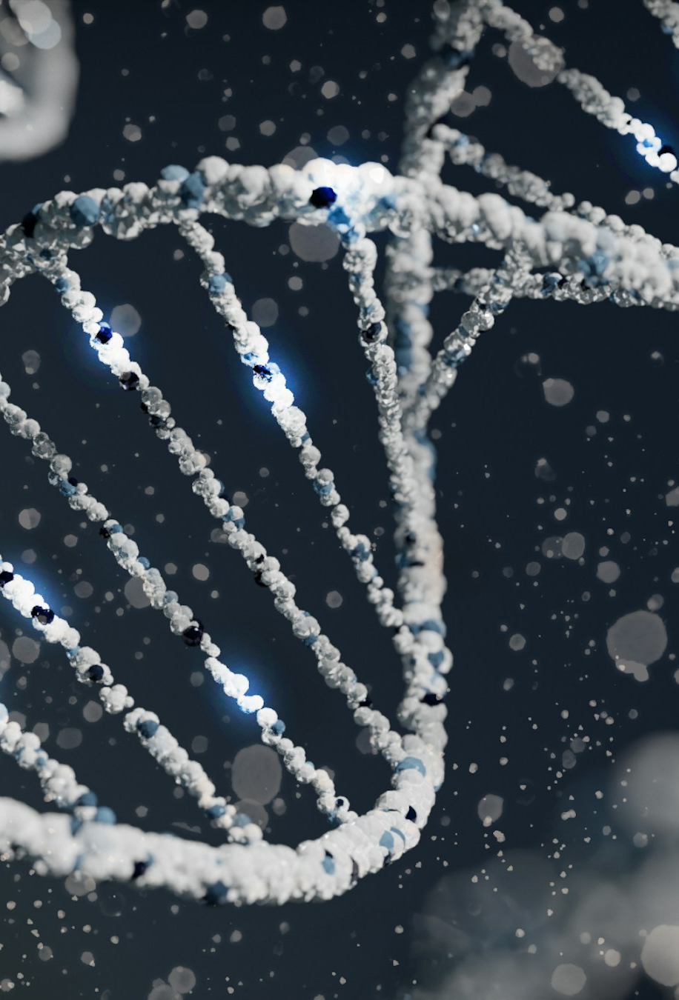


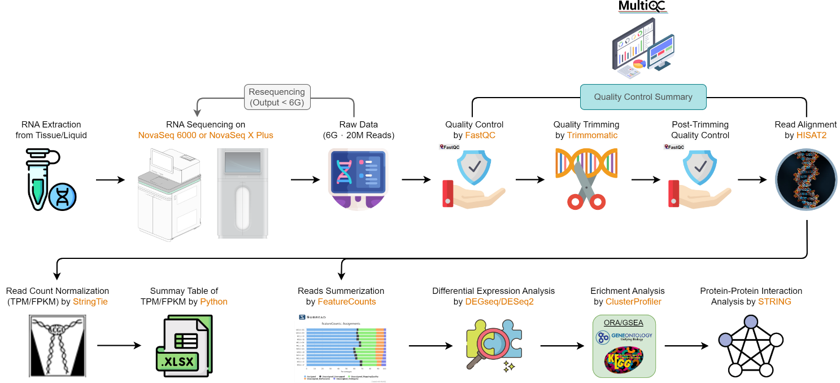
<
?
single-cell RNA-seq
bulk RNA-seq
TGIA pipeline

Slide 3
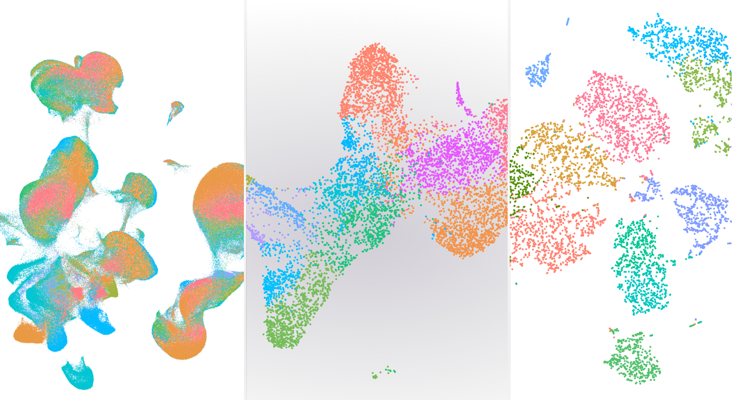

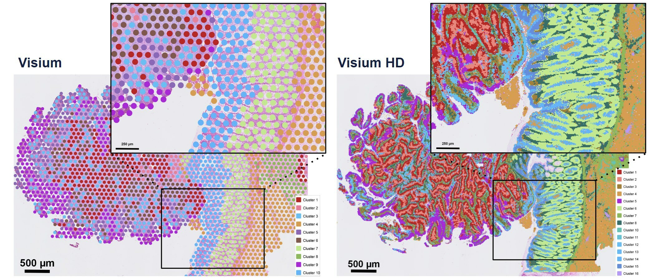


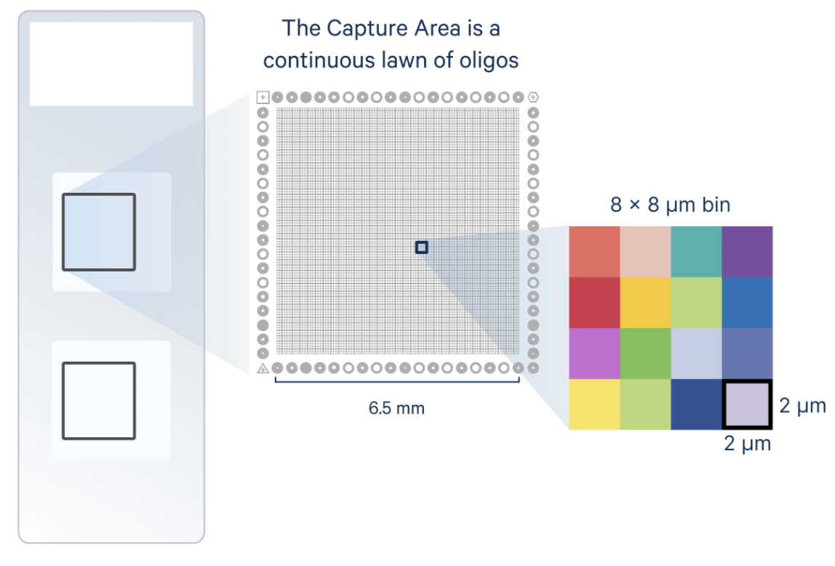
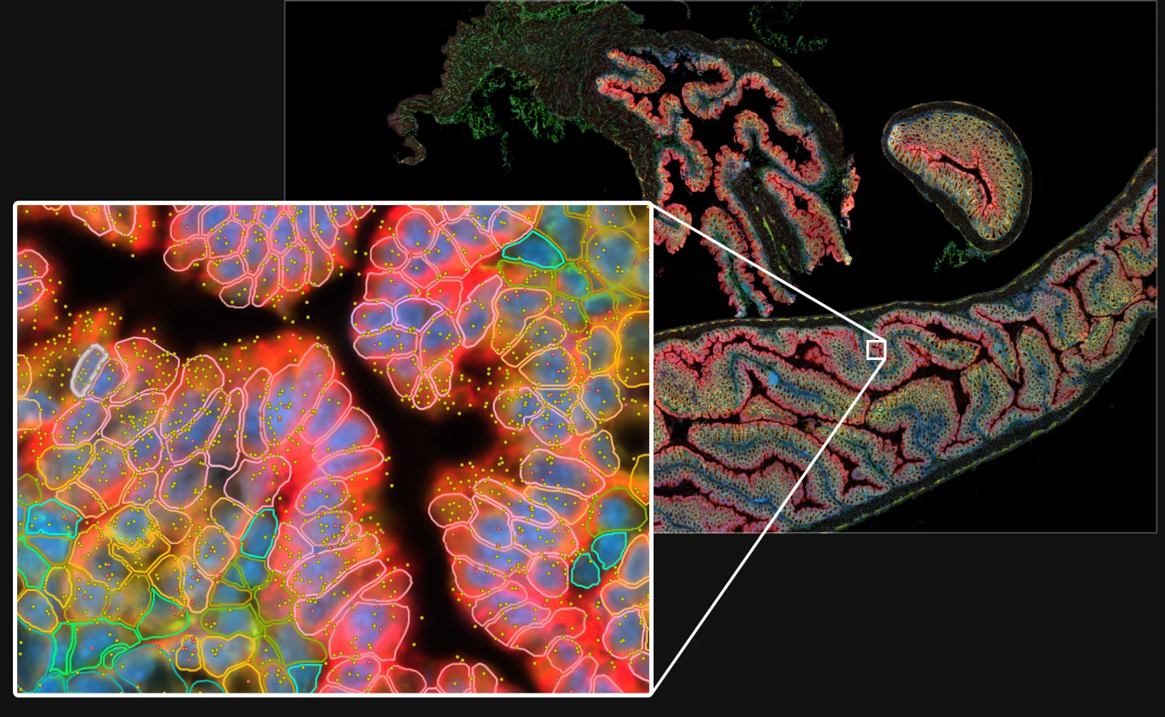

Chromium
Visium CytAssist
Xenium Analyzer
https://www.10xgenomics.com/products

Slide 4
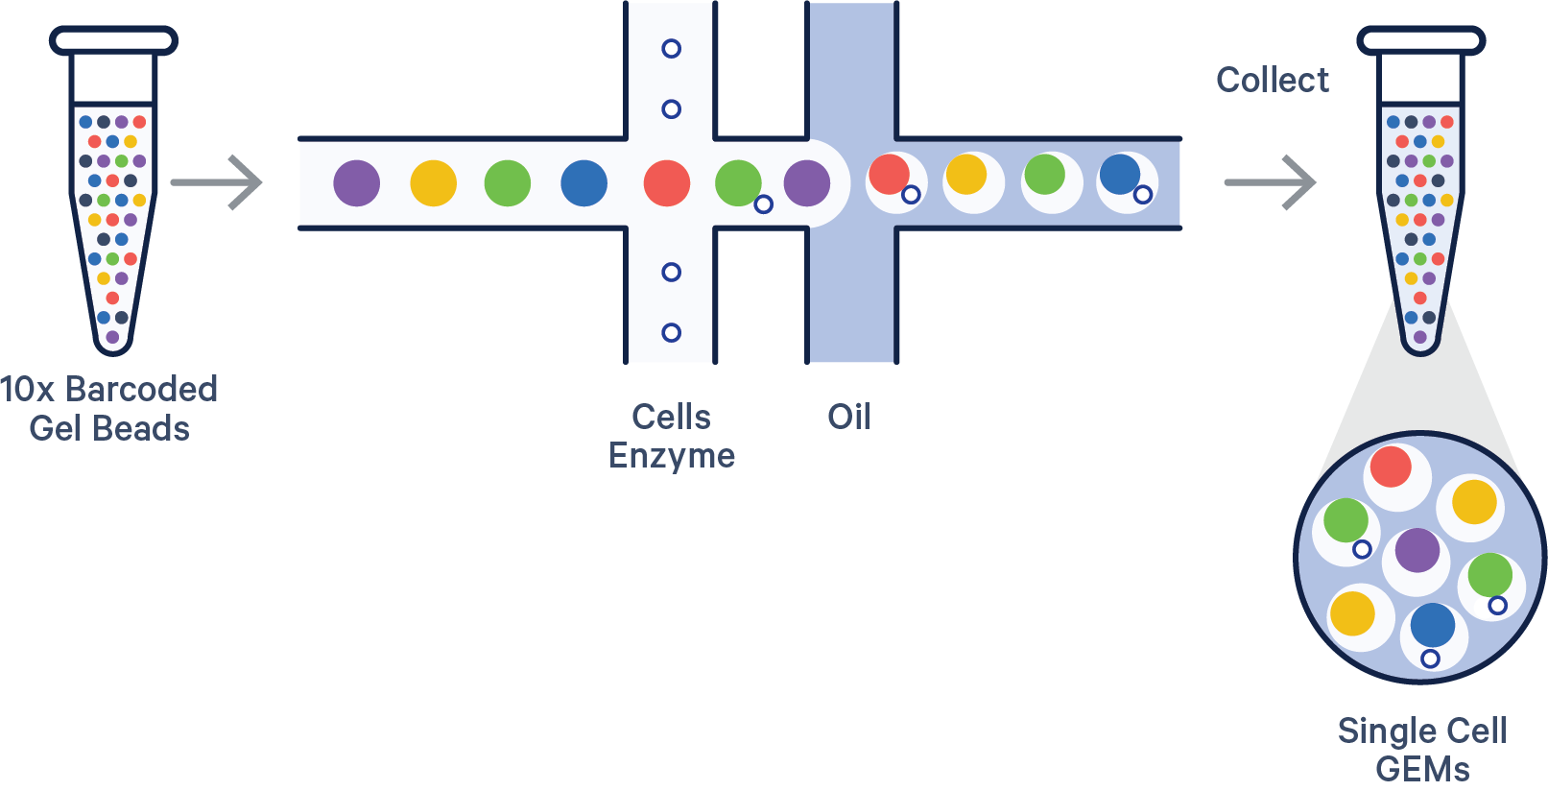
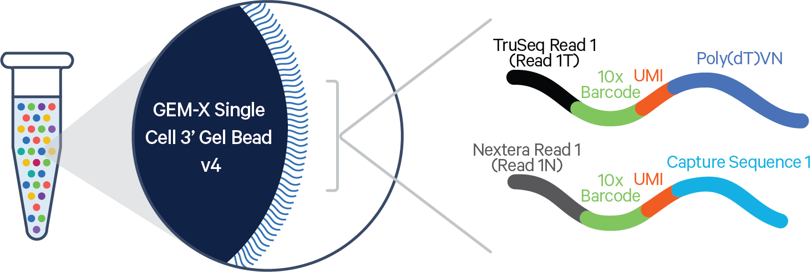
What’s new in scRNAseq?

Slide 5
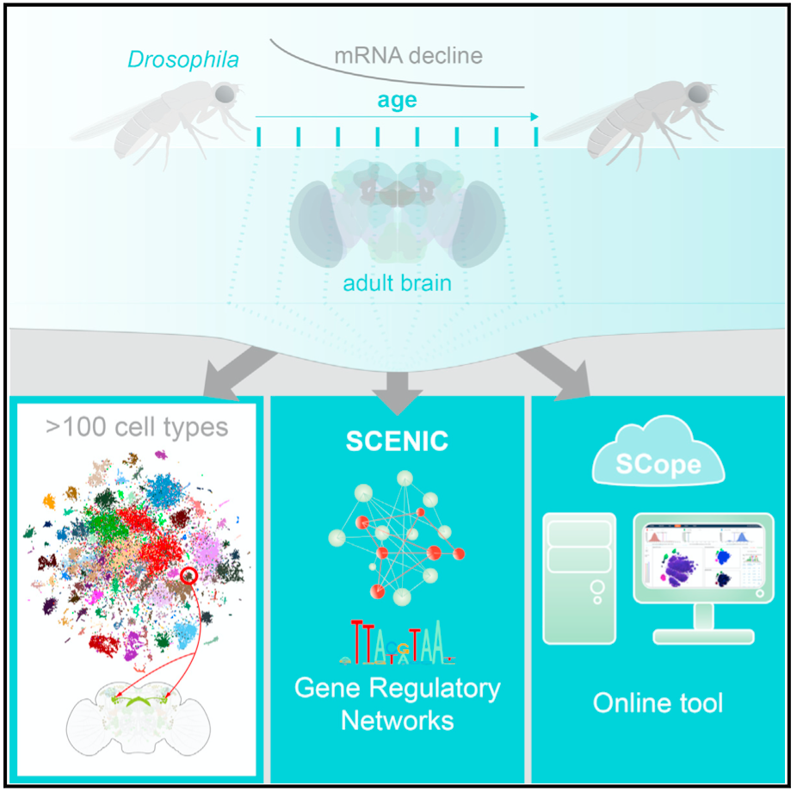
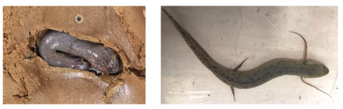
Single-cell RNA-seq in model and non-model organisms
Drosophila melanogaster
Brain
Davie et al., 2018. Cell (IF=64.5)
West African lungfish (Protopterus annectens)
Lung & Gill
Zhang et al., 2023. Nat Comm (IF=16.6)

Slide 6
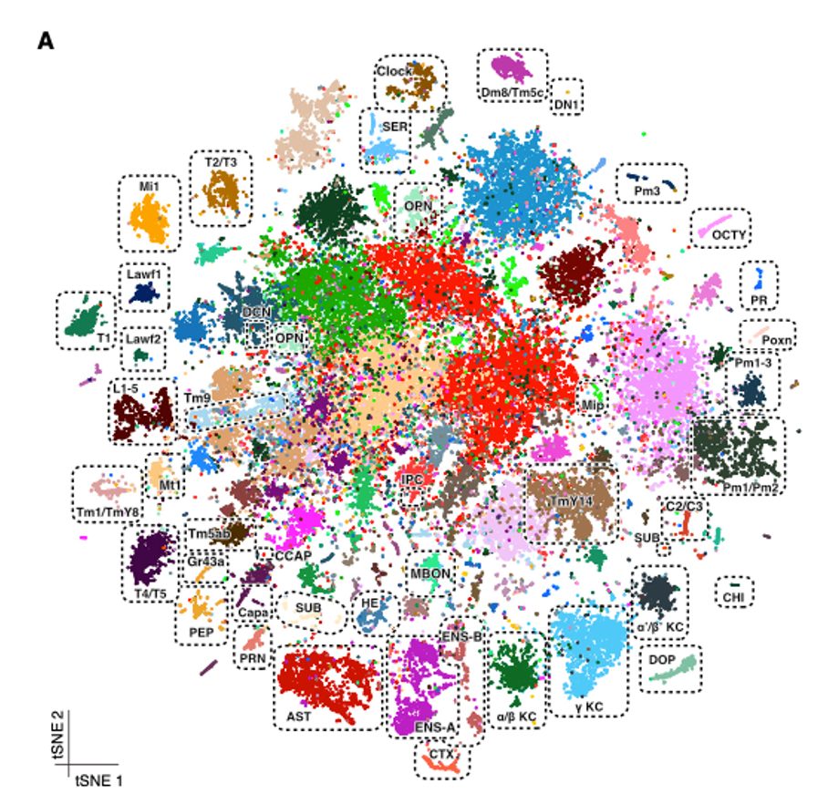

A Single-Cell Transcriptome Atlas of the Aging Drosophila Brain
57k good quality cells
37 cell types
Davie et al. (2018)

Slide 7
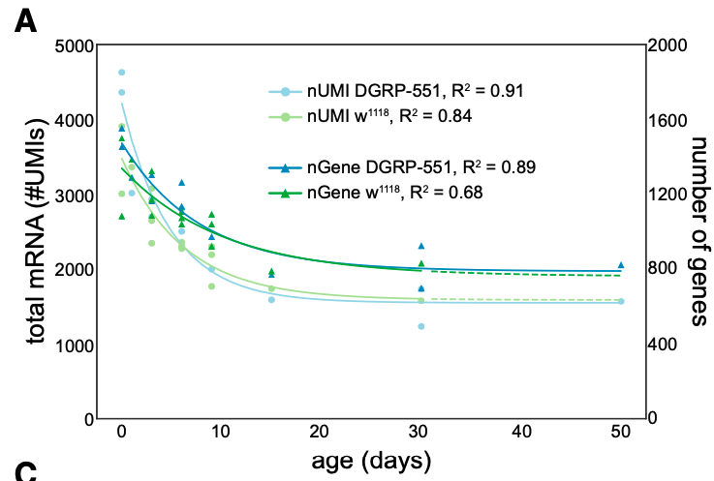
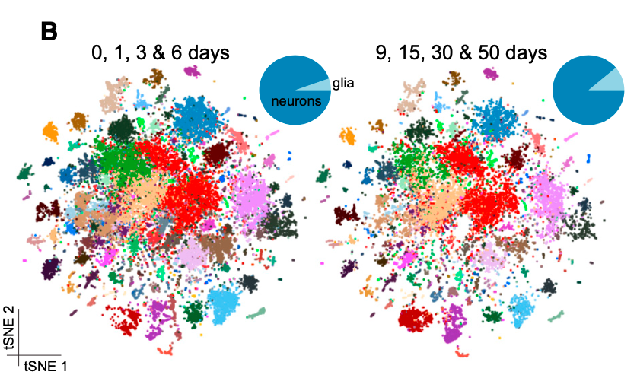
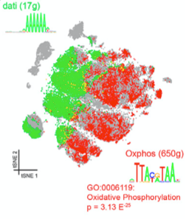
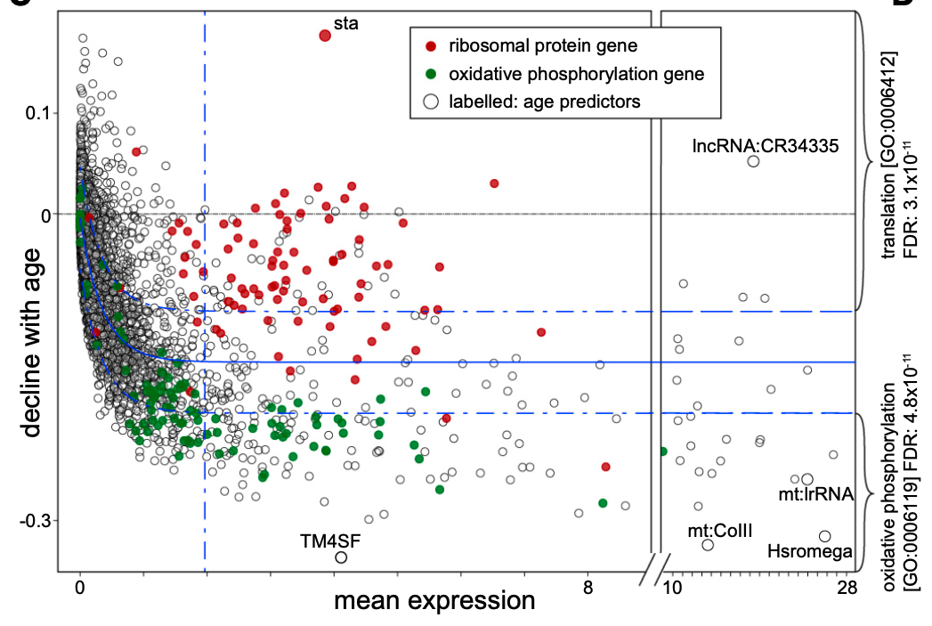
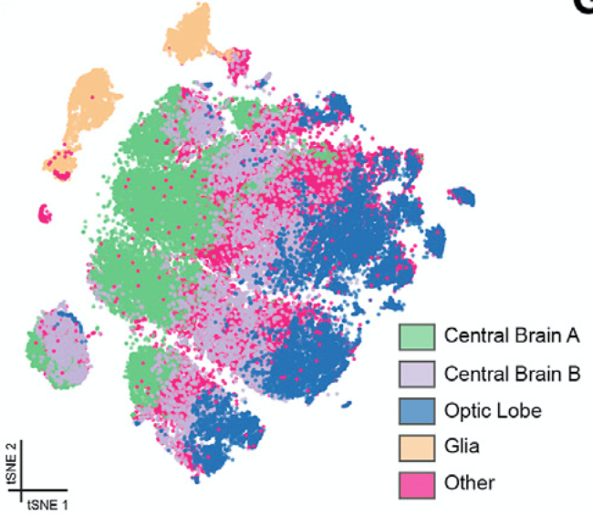
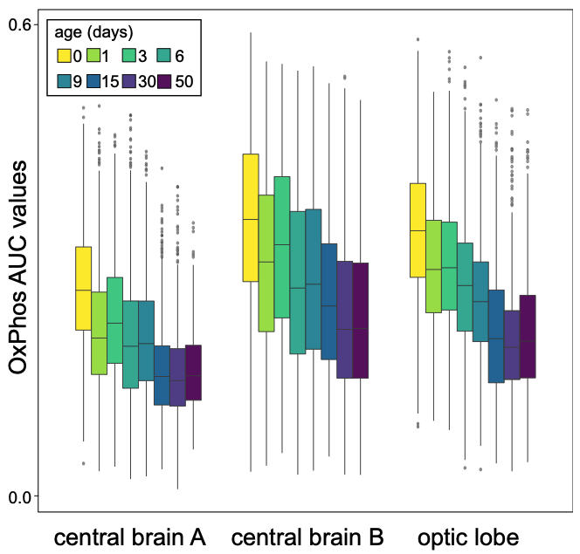

Slide 8
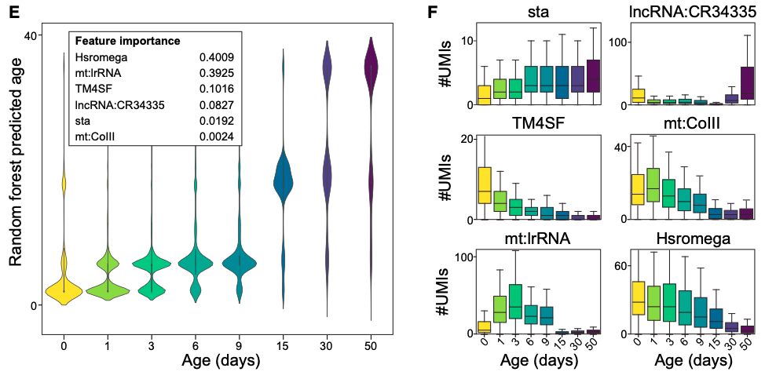
Age can be accurately predicted by the transcriptome
8

Slide 9
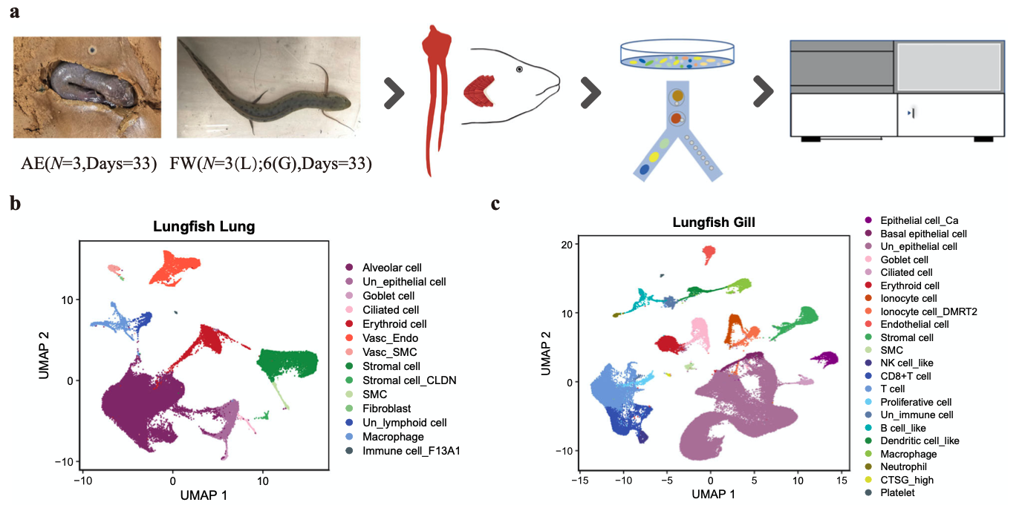

A single-cell atlas of West African lungfish respiratory system reveals evolutionary adaptations to terrestrialization
Lung: 53605 cells, 14 cell types
Gill: 87347 cells, 22 cell types
Zhang et al. (2023)

Slide 10
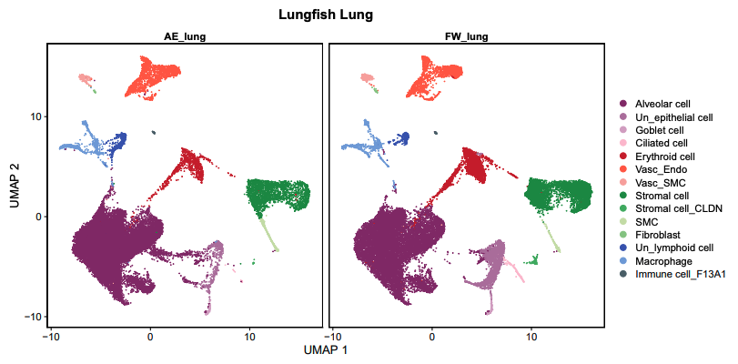
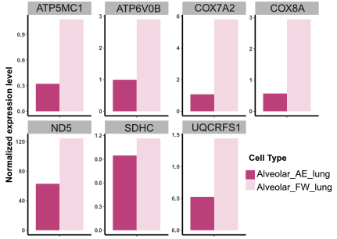
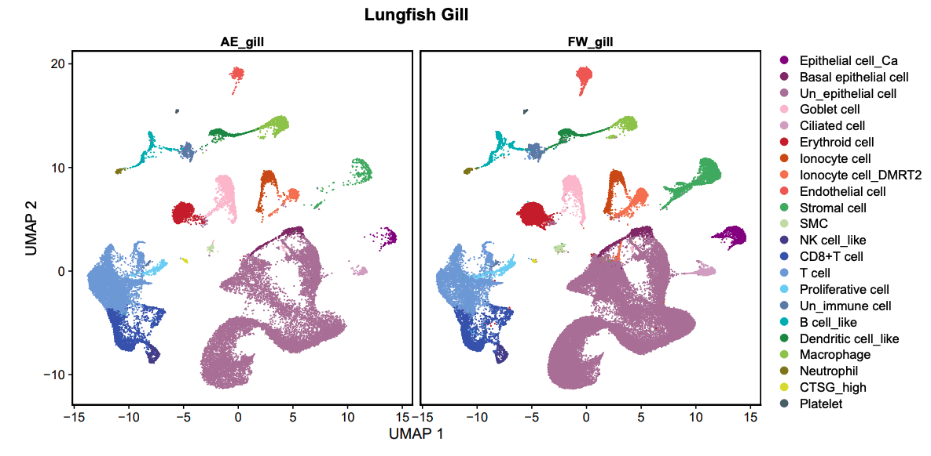
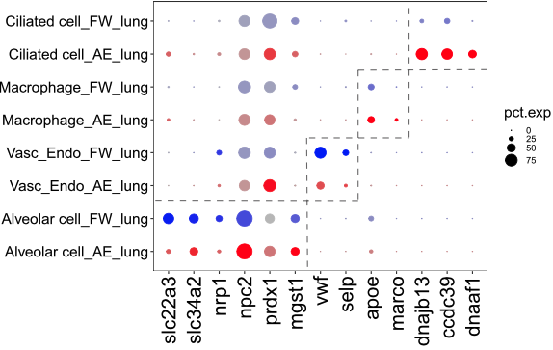
陸化
有水

Slide 11
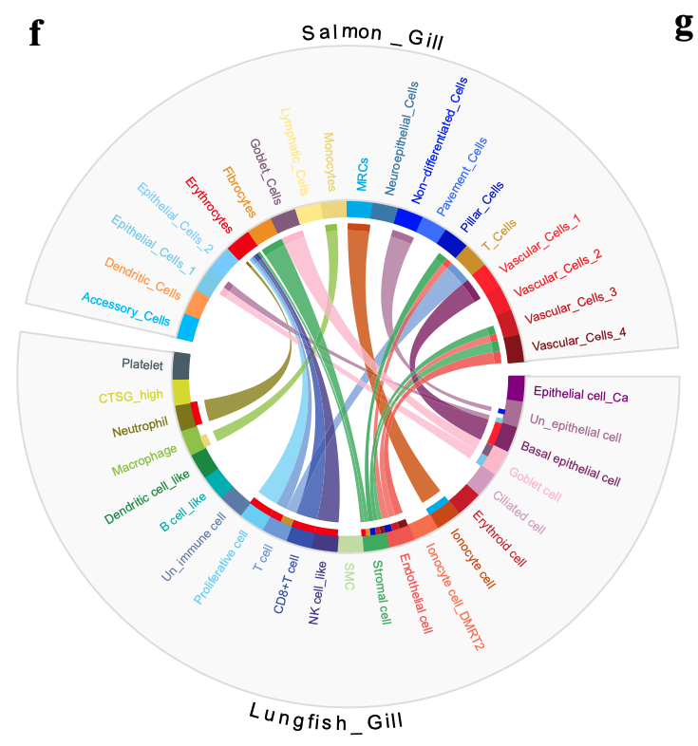
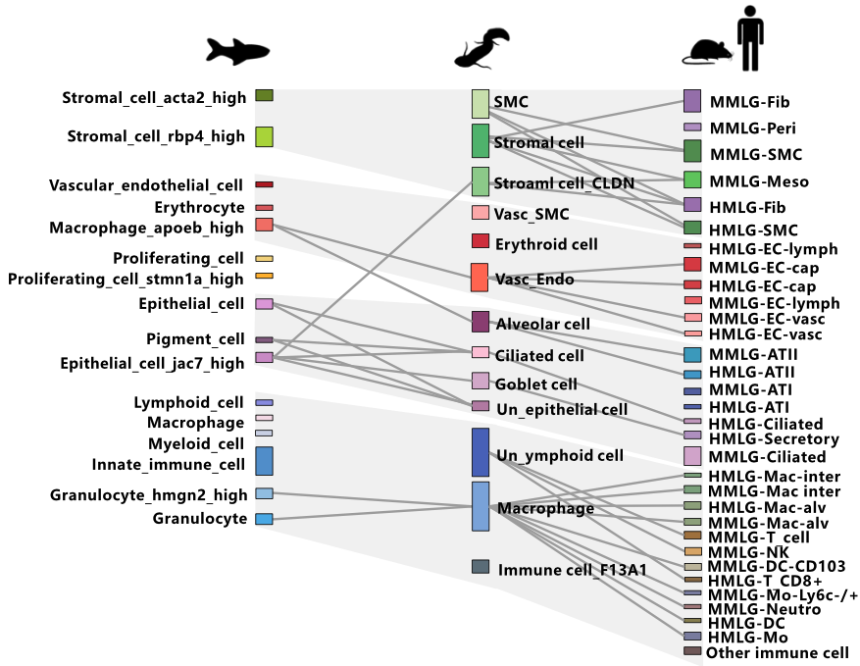
Cell type evolution of the lung and gill

Slide 12
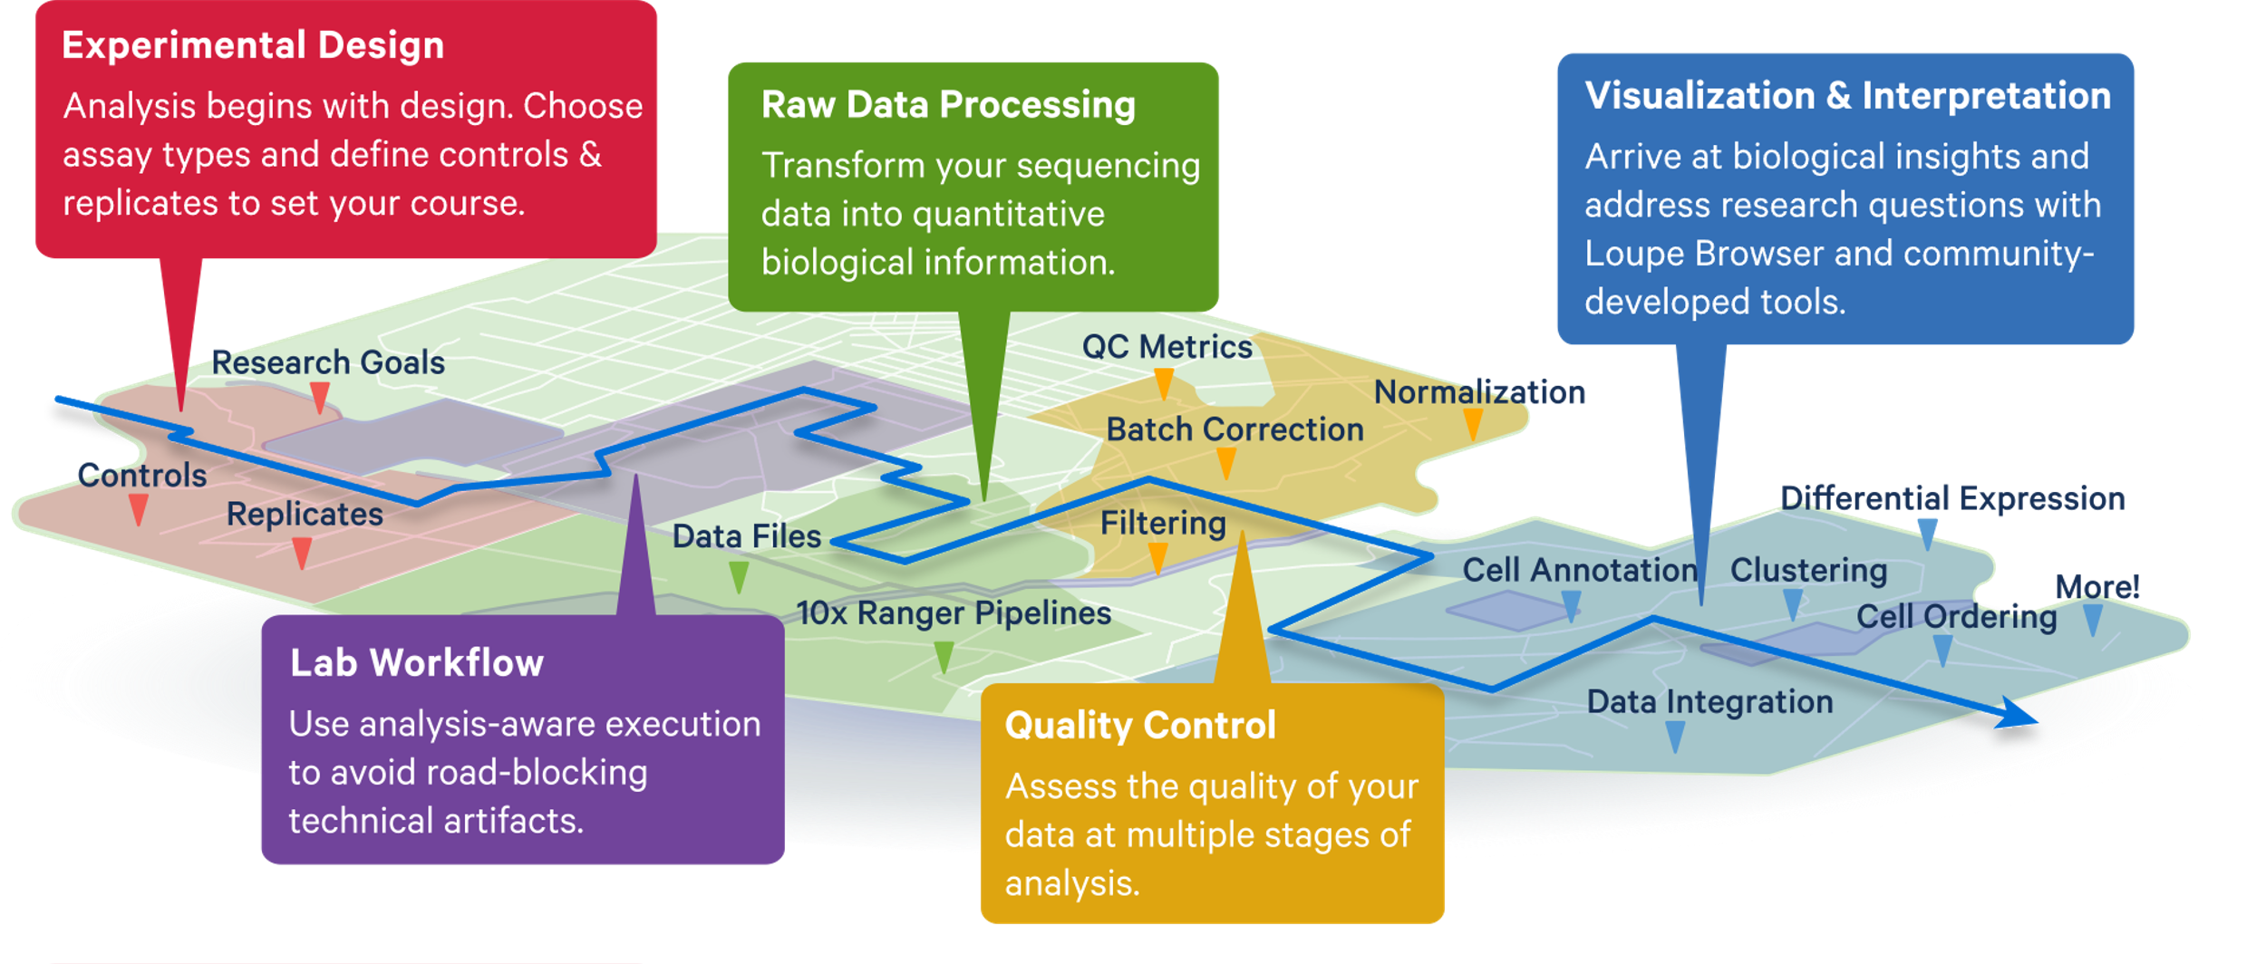
Single-cell RNA-seq data analysis

Slide 13
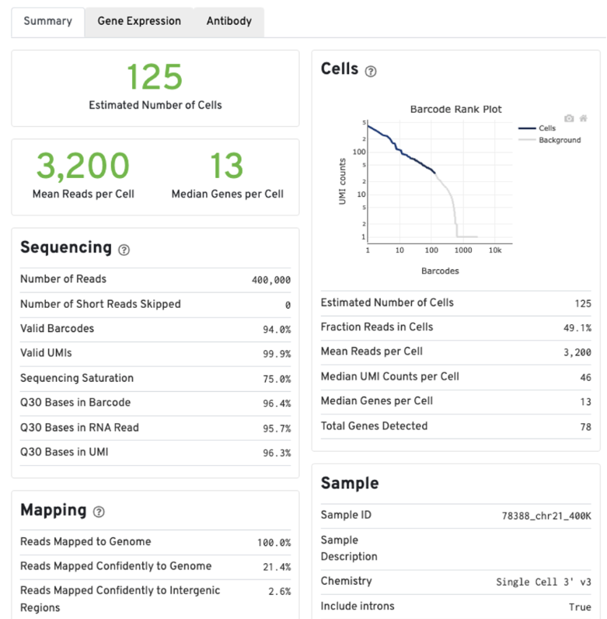
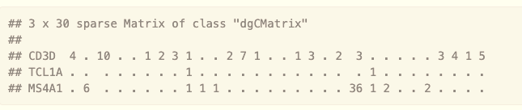
CellRanger
Aligns sequencing reads in FASTQ files to a reference transcriptome (cellranger count)
  require the reference

Slide 14
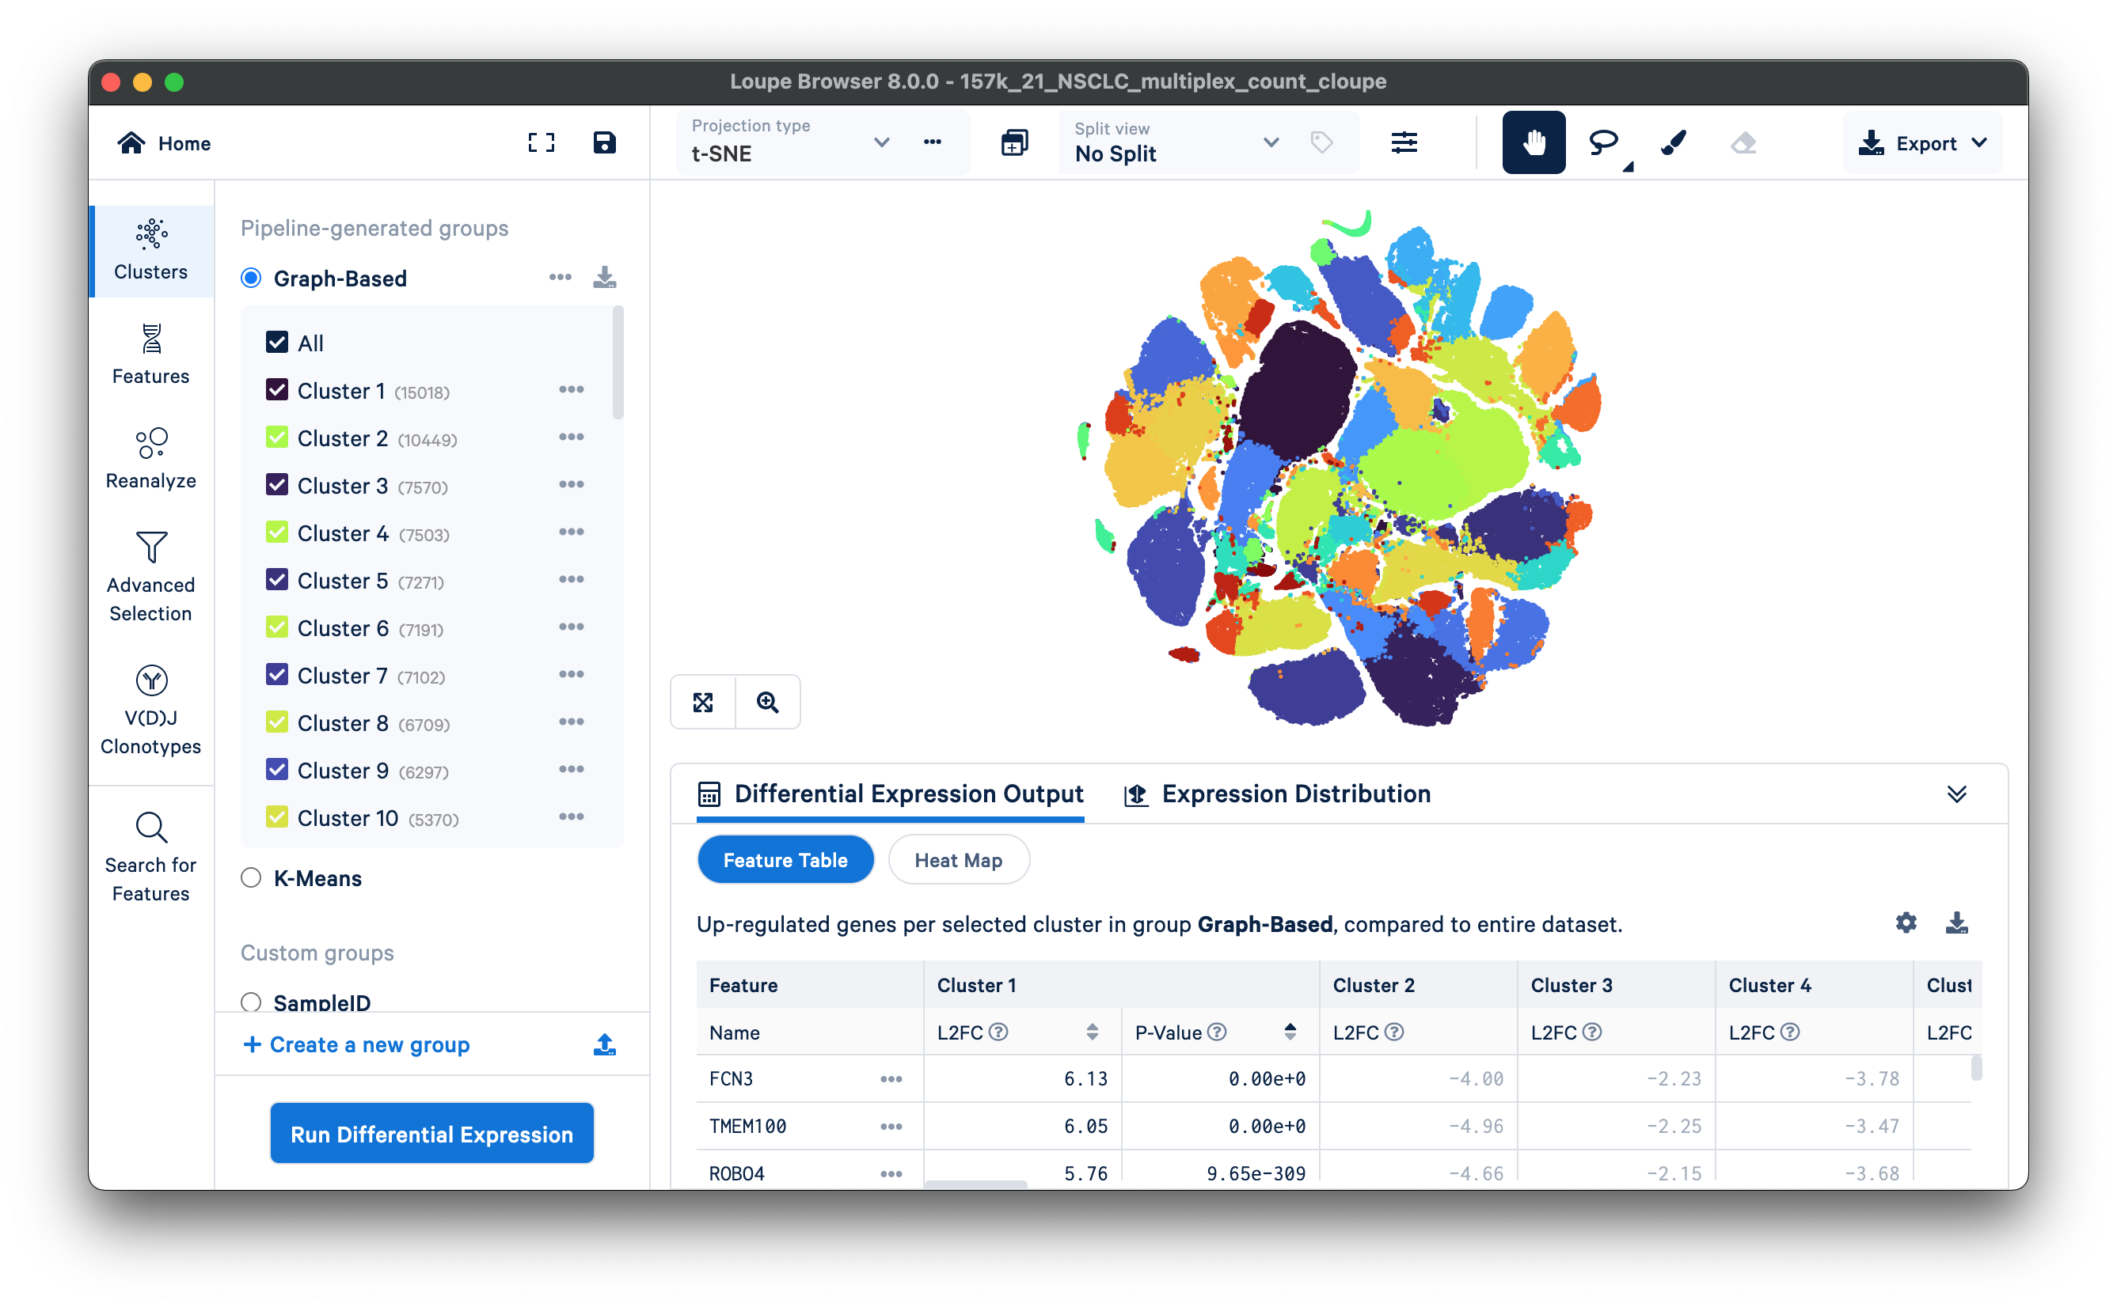
Loupe Browser 8.0.0

Slide 15

Seurat v5 – Standard Pipeline (step-by-step)
Remove ambient RNA
Gene-level filtering
Cell-level filtering
Remove batch effect
Normalization
Cell typing
Quality
Control
Integration
&
Clustering
DEG analysis
Count matrix
LogNormalize
SCTransform
Rahul Satija

Slide 16

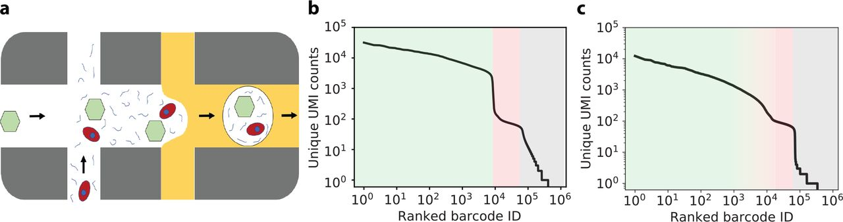
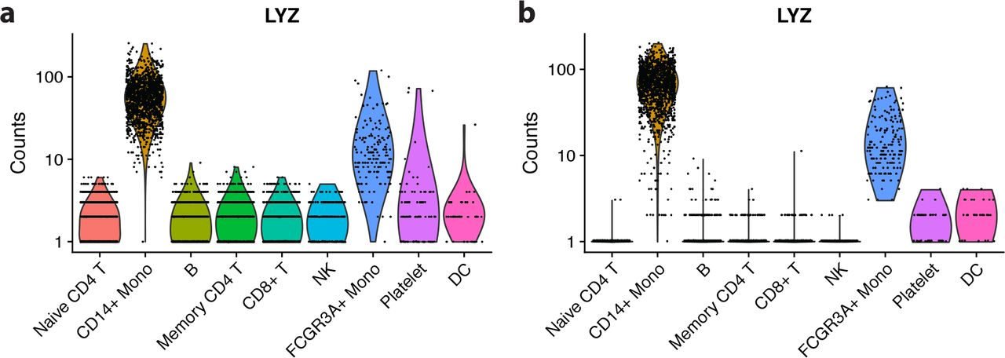
Remove ambient RNA - CellBender
16

Slide 17

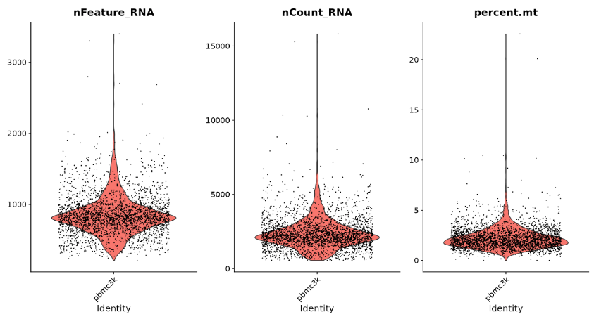
Gene-level/ Cell-level filtering
基因數量
UMI數量
17

Slide 18
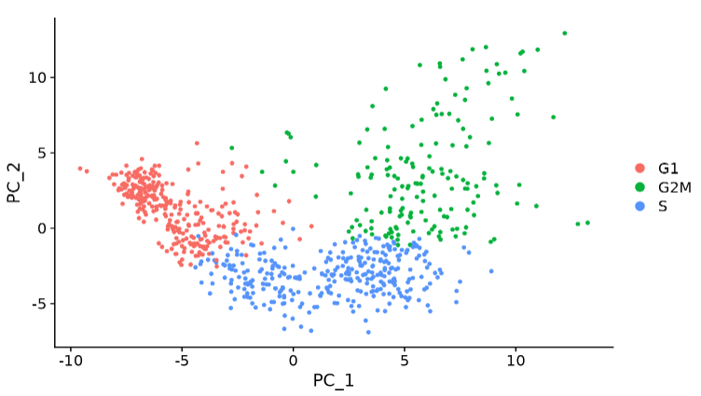
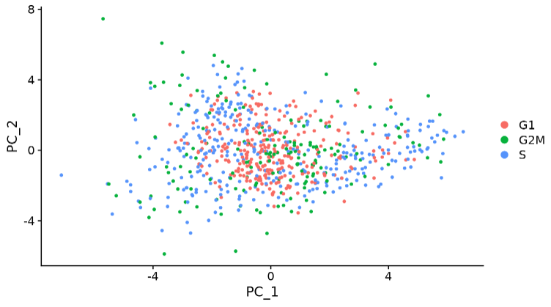
Normalization
Goal: The variance of a normalized gene (across cells) should primarily reflect biological heterogeneity, independent of technical heterogeneity (sequencing depth) and other unwanted variance.
LogNormalize
SCTransform (Choudhary and Satija, 2022. Genome Biol)
18

Slide 19
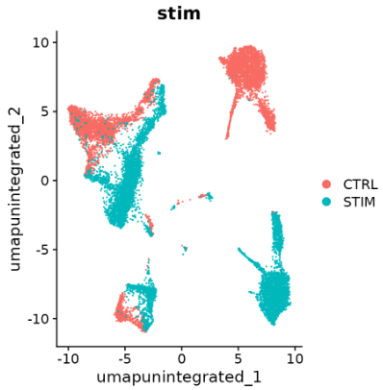
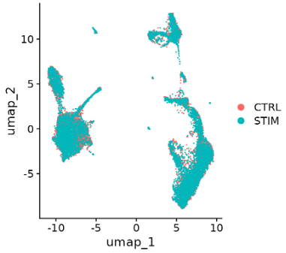
Integration
Goal: Integration across experimental batches, donors, or conditions can facilitate accurate comparative analysis across datasets.
19

Slide 20
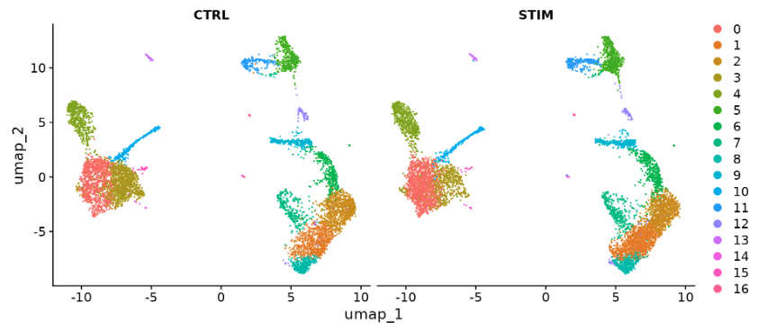
Clustering
Goal: to make groups where members are more connected to each other than to members of other groups.
20

Slide 21
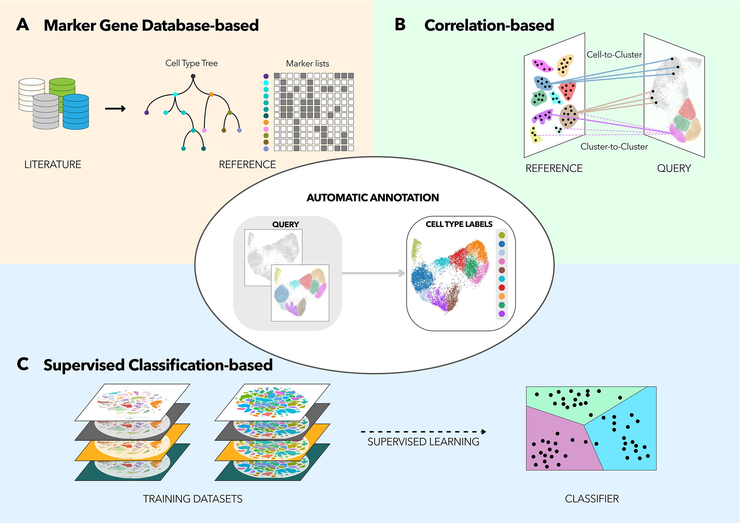
Cell typing
Rely on background knowledge
  Marker genes
  Published literatures
Multiple automated tools
  Correlation-based
  Marker gene database-based
  Supervised classification-based
21

Slide 22
DEG in scRNAseq
比較特定的兩個 cluster
FindMarkers
比較特定的 cluster 與其他所有細胞
FindAllMarkers
比較比較特定的兩個 cluster
在兩種處理下
FindConserved-Markers

Slide 23

Thank you!

Slide 24

Cell Calling - CellRanger
“
The algorithm is based on the EmptyDrops method (Lun et al., 2019) and operates in two main phases:
Initial cell identification: apply a threshold based on total UMI counts per barcode to pinpoint cells, effectively distinguishing the initial set of high RNA content cells.
Refinement: examine the RNA profiles of the remaining barcodes to differentiate between "empty" and cell-containing partitions, thereby identifying low RNA content cells that may have UMI counts similar to those of empty GEMs.

Slide 25
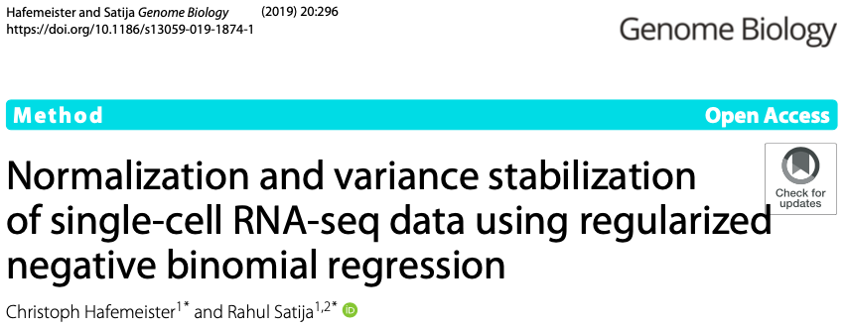

SCTransform

Slide 26
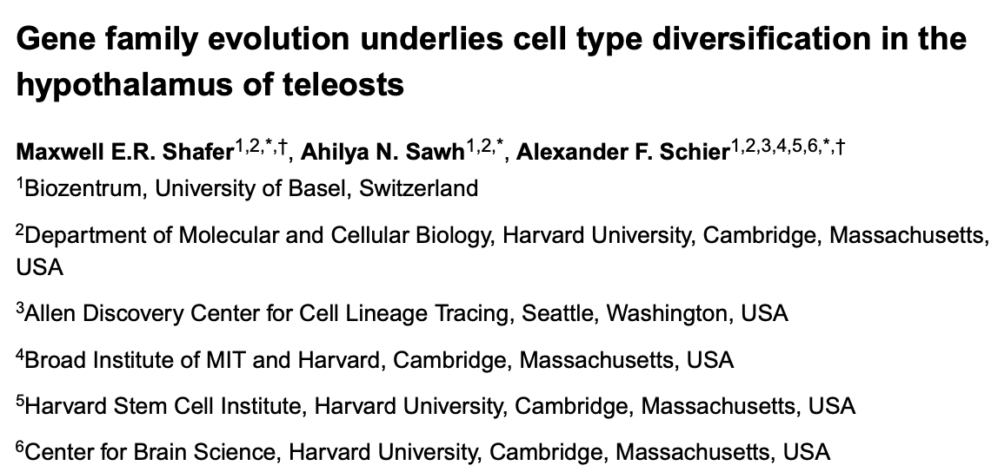

Orthologous Gene

Slide 27
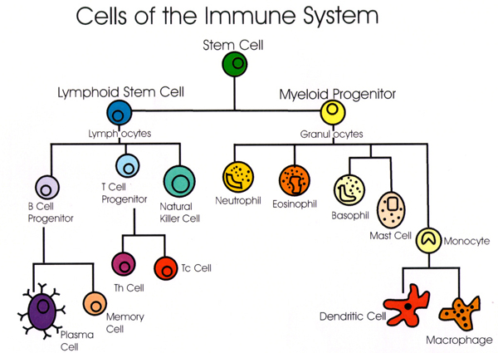
PBMC 3k dataset
https://textbookofbacteriology.net/adaptive_2.html

